Slide 1
Assignment – XG Boost/ Extreme Gradient Boosting
Submitted By : Pooran Pragnya
November Batch (BDS)

Slide 2
XG Boost/Extreme Gradient Boosting
XG Boost is an advanced implementation of gradient boosting along with some regularization factors.
XG Boost or extreme gradient boosting is one of the well known boosting techniques (ensemble technique) having enhanced performance.
It has higher speed when compared with other types of decision trees.
Earlier only Python and R packages were built for XG Boost but now it has extended to Java, Scala, Julia and other languages as well.
The main benefit of the XG Boost implementation is computational efficiency and often better model performance.

Slide 3
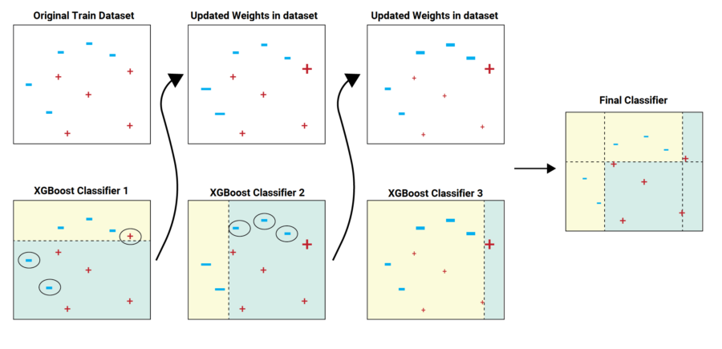

Slide 4
Methodology:
In this algorithm, decision trees are created in sequential form. Weights play an important role in XGBoost. Weights are assigned to all the independent variables which are then fed into the decision tree which predicts results. The weight of variables predicted wrong by the tree is increased and these variables are then fed to the second decision tree. These individual classifiers/predictors then ensemble to give a strong and more precise model. It can work on regression, classification, ranking, and user-defined prediction problems.

Slide 5
Features of XG Boost:
It can run on both single and distributed systems (Hadoop, Spark).
It supports parallel processing (multiple models can run at one time).
It can be used in both classification as well as regression problems.
It has cache optimization option.
It has efficient memory management for larger datasets exceeding RAM.
It has auto tree pruning – Decision tree will not grow further after certain limits internally.
It has a variety of regularizations which help in reducing overfitting.
It can handle missing values.
It has inbuilt cross – validation.

